Slide 1
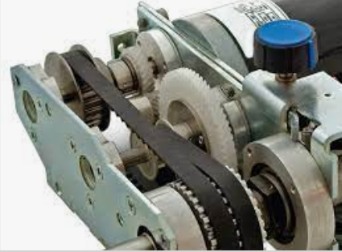
SYNCHRONOUS BELT DRIVES

Slide 2
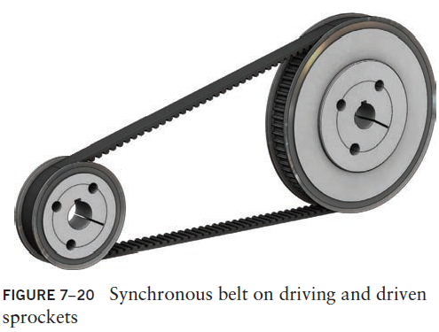
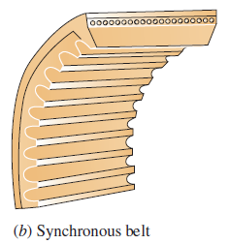
Synchronous Belt Drives
Synchronous belts are constructed with ribs or teeth across the underside of the belt

Slide 3
Synchronous Belt Drives
The teeth mate with corresponding grooves in the driving and driven pulleys, called sprockets, providing a positive drive without slippage.
Therefore, there is a fixed relationship between the speed of the driver and the speed of the driven sprocket.
Synchronous belts are often called timing belts and when properly designed will have an efficiency as high as 98%.
Synchronous belts can therefore be used for applications such as automatic machinery where a definite motion sequence or indexing is necessary.

Slide 4
Synchronous Belt Drives
Synchronous action is critical to the successful operation of such systems as printing, material handling, packaging, and assembly.
Synchronous belt drives are increasingly being considered for applications in which gear drives or chain drives had been used previously.
Because of the nature of synchronous belt mechanisms, they are also called ‘timing belt’ mechanisms. And they can be used in machinery where precision is very important. At power transmission of 3D printers, robotic mechanisms, synchronous belt drive mechanisms are generally used.

Slide 5
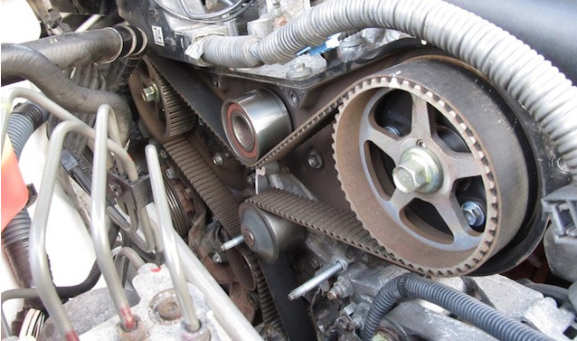
If you look at the front of the engine under the timing cover, you’ll find a tooth belt in some cases (although in most current vehicles, this belt is replaced by a chain).
It’s attached to the crankshaft and camshaft via several pulleys. Also called a gilmer drive belt many years ago.
The timing belt has two jobs.
It powers the engine’s camshaft
It keeps it exactly in sync with the crankshaft. This ensures that the valves open and close at the right time. That’s why it’s called a timing belt. It times the valvetrain.

Slide 6
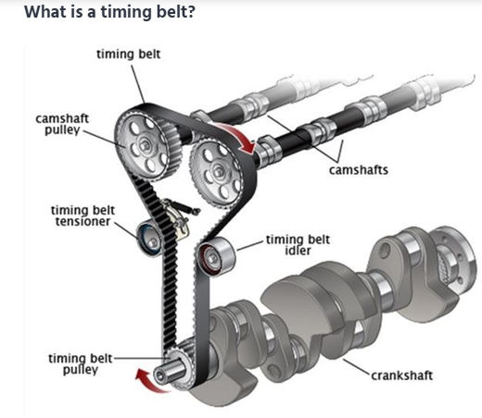
Most internal combustion engines utilize a similar design, with a crankshaft at the bottom, and a camshaft above it. Both shafts spin, with the crankshaft connected to the pistons; rotating as the pistons move up and down. The camshaft uses a series of lobes to open and close the valves, which let air in and out of your engine.
Since it’s crucial that the valves open and close at the correct time, the crankshaft and camshaft are connected by a timing belt, or timing chain.
If this valve timing is not correct, the engine will perform poorly – or worse, may damage itself.
If your car is equipped with a timing belt, it is the single most important maintenance item on your vehicle.

Slide 7
Advantages of Synchronous Belt Drives
Synchronous belts provide a positive and trouble-free transmission of power and offer these advantages:
High capacity
Highly accurate registration
Low vibration
Low noise
No lubrication required
No stretching due to wear
Corrosion resistance
Abrasion resistance
Clean operation

Slide 8
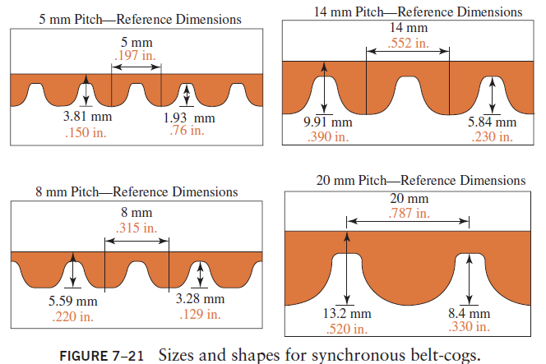
Sizes and Shapes for Synchronous Belts

Slide 9
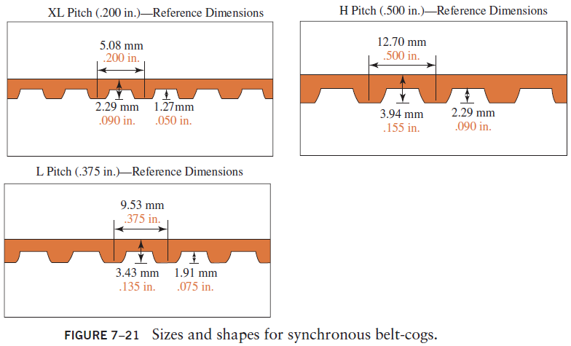
Sizes and Shapes for Synchronous Belts

Slide 10
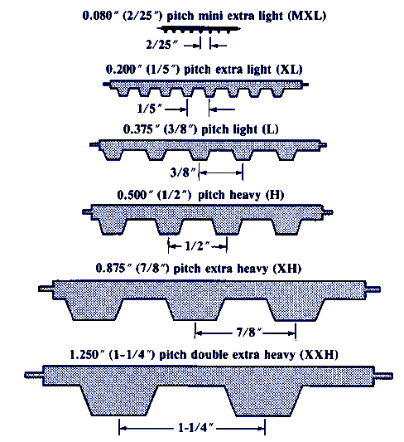

Slide 11
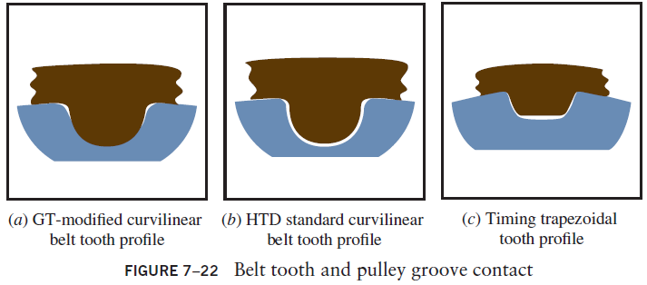
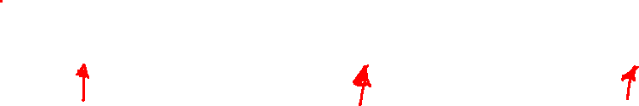
Belt Tooth Shape
(c) better timing and indexing
(b) high load-carrying capacity and is used in high-torque applications
(a) GT(Gates Tooth)-modified curvilinear tooth profile that offers improved indexing accuracy over the HTD

Slide 12
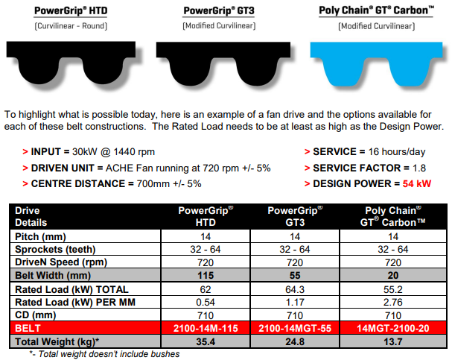

Slide 13
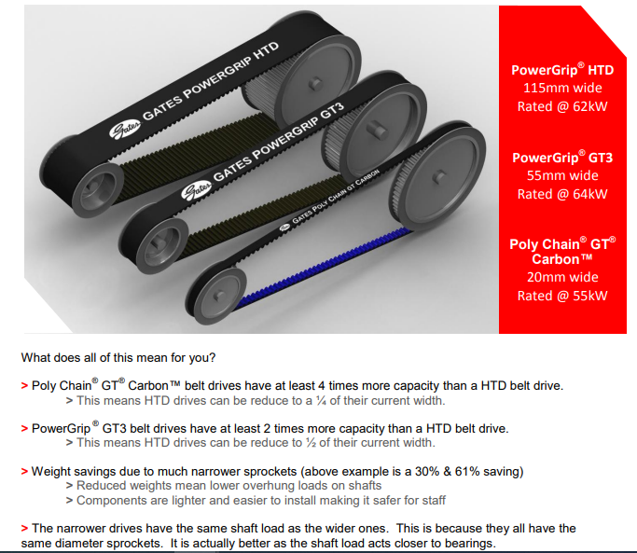

Slide 14
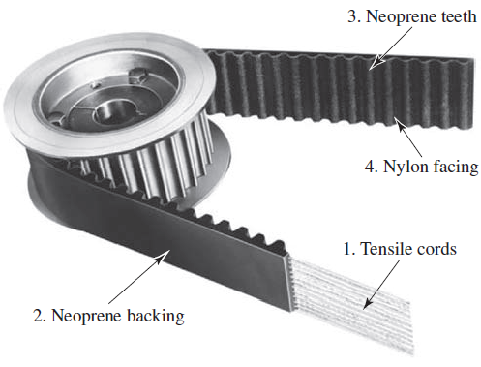

Synchronous Belt Construction

Slide 15
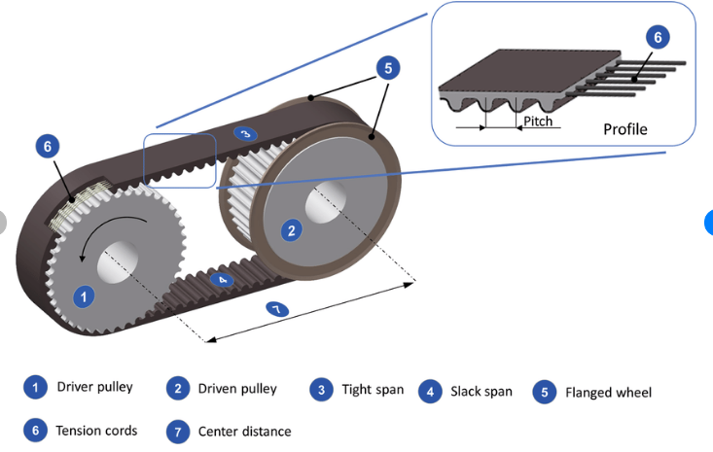

Slide 16
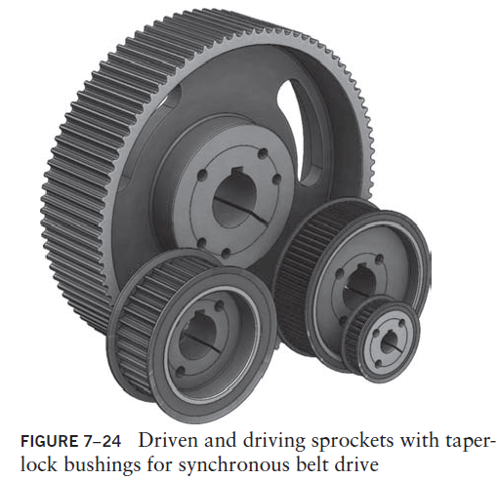
Sprockets and Bushings

Slide 17
Belt Dimensions
Various widths of belts are available for each given pitch to provide a wide range of power transmission capacity.
Belts are also available in various perimeter lengths. This allows a two-sprocket belt drive system to have a wide range of center distances
Belt Designation: 1760-8MGT-30
The first set of numbers (in mm) represents the belt perimeter, the second set represents the belt pitch with the style of the tooth profile, and the last number represents the belt width.

Slide 18
Sprocket Designations
Table 7–4 shows the available sprockets with a pitch of 8 mm.
The corresponding taper-lock bushing number is given for each sprocket and is based on the sprocket width.
Sprocket Designation: P72-8MGT-50
The first set of numbers (in mm) represents the number of teeth, the second set represents the belt pitch with the style of tooth profile, and the last number is the belt width.

Slide 19
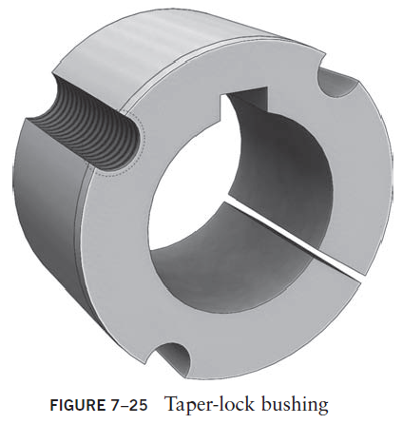
Taper-Lock Bushing
The taper-lock bushing minimum and maximum bore diameters will limit the size of the shaft for a specific sprocket.
The three half holes are aligned with the three half holes in the sprocket and are used to tighten the taper-lock bushing to the sprocket and remove the taper-lock bushing from the sprocket.

Slide 20
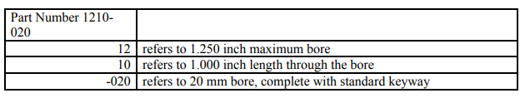
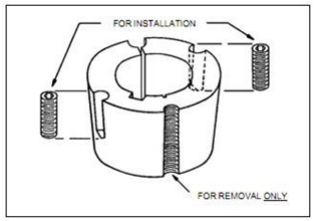
Taper-Lock Bushing
When installing or removing a Taper Lock bush, it is imperative that no lubrication be used between the taper.
The presence of lubricant on the tapered surfaces is not desirable, as the taper bushing relies on friction to operate effectively, and lubricants reduce friction.
We use industry standard Part Numbers to identify the specifications of each Taper Lock bush or Taper bush. For example:

Slide 21
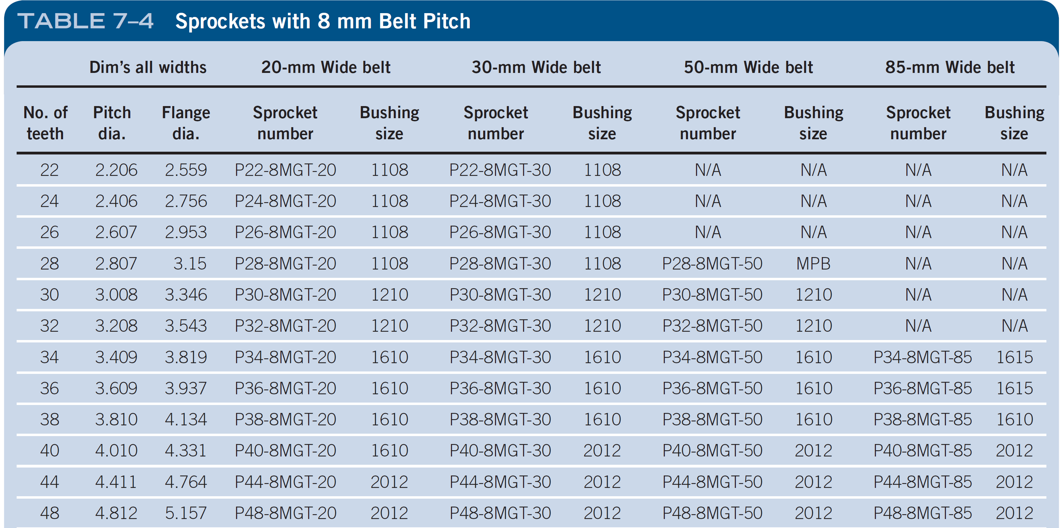
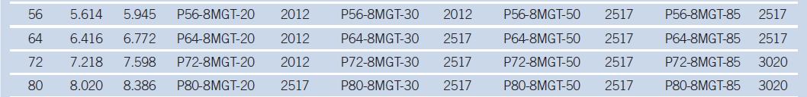
Sprockets with 8mm Belt Pitch

Slide 22
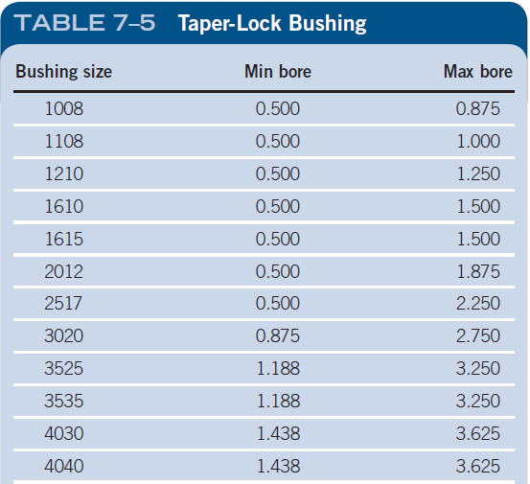
Taper-Lock Bushing

Slide 23
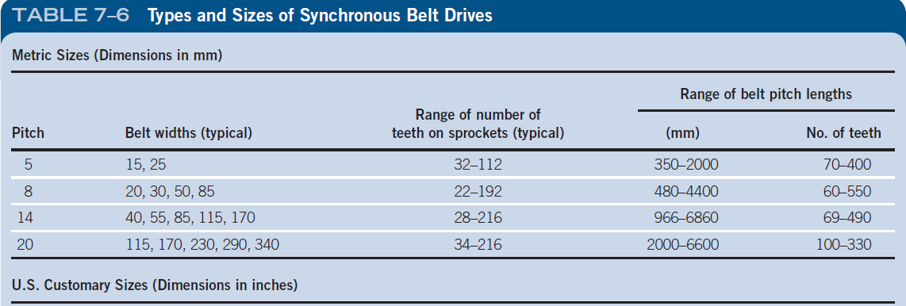
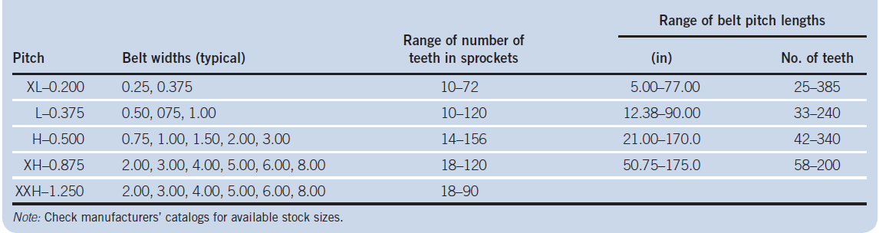

Slide 24
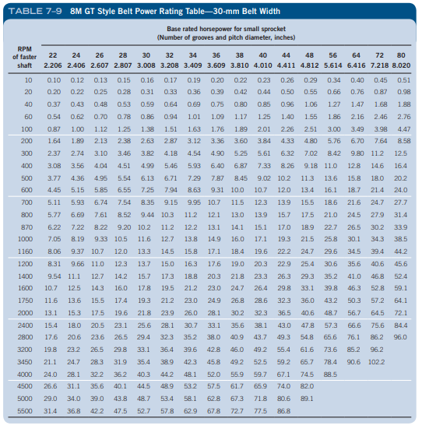

Slide 25
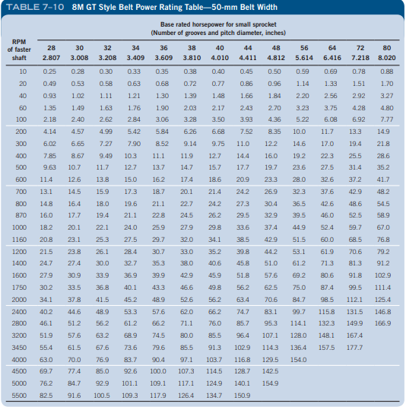

Slide 26
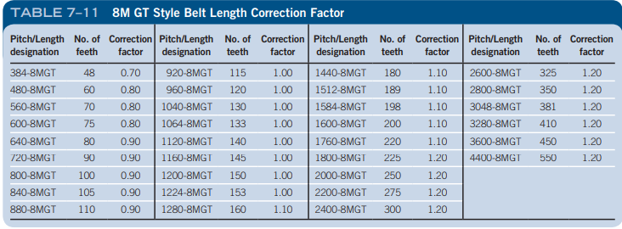

Slide 27
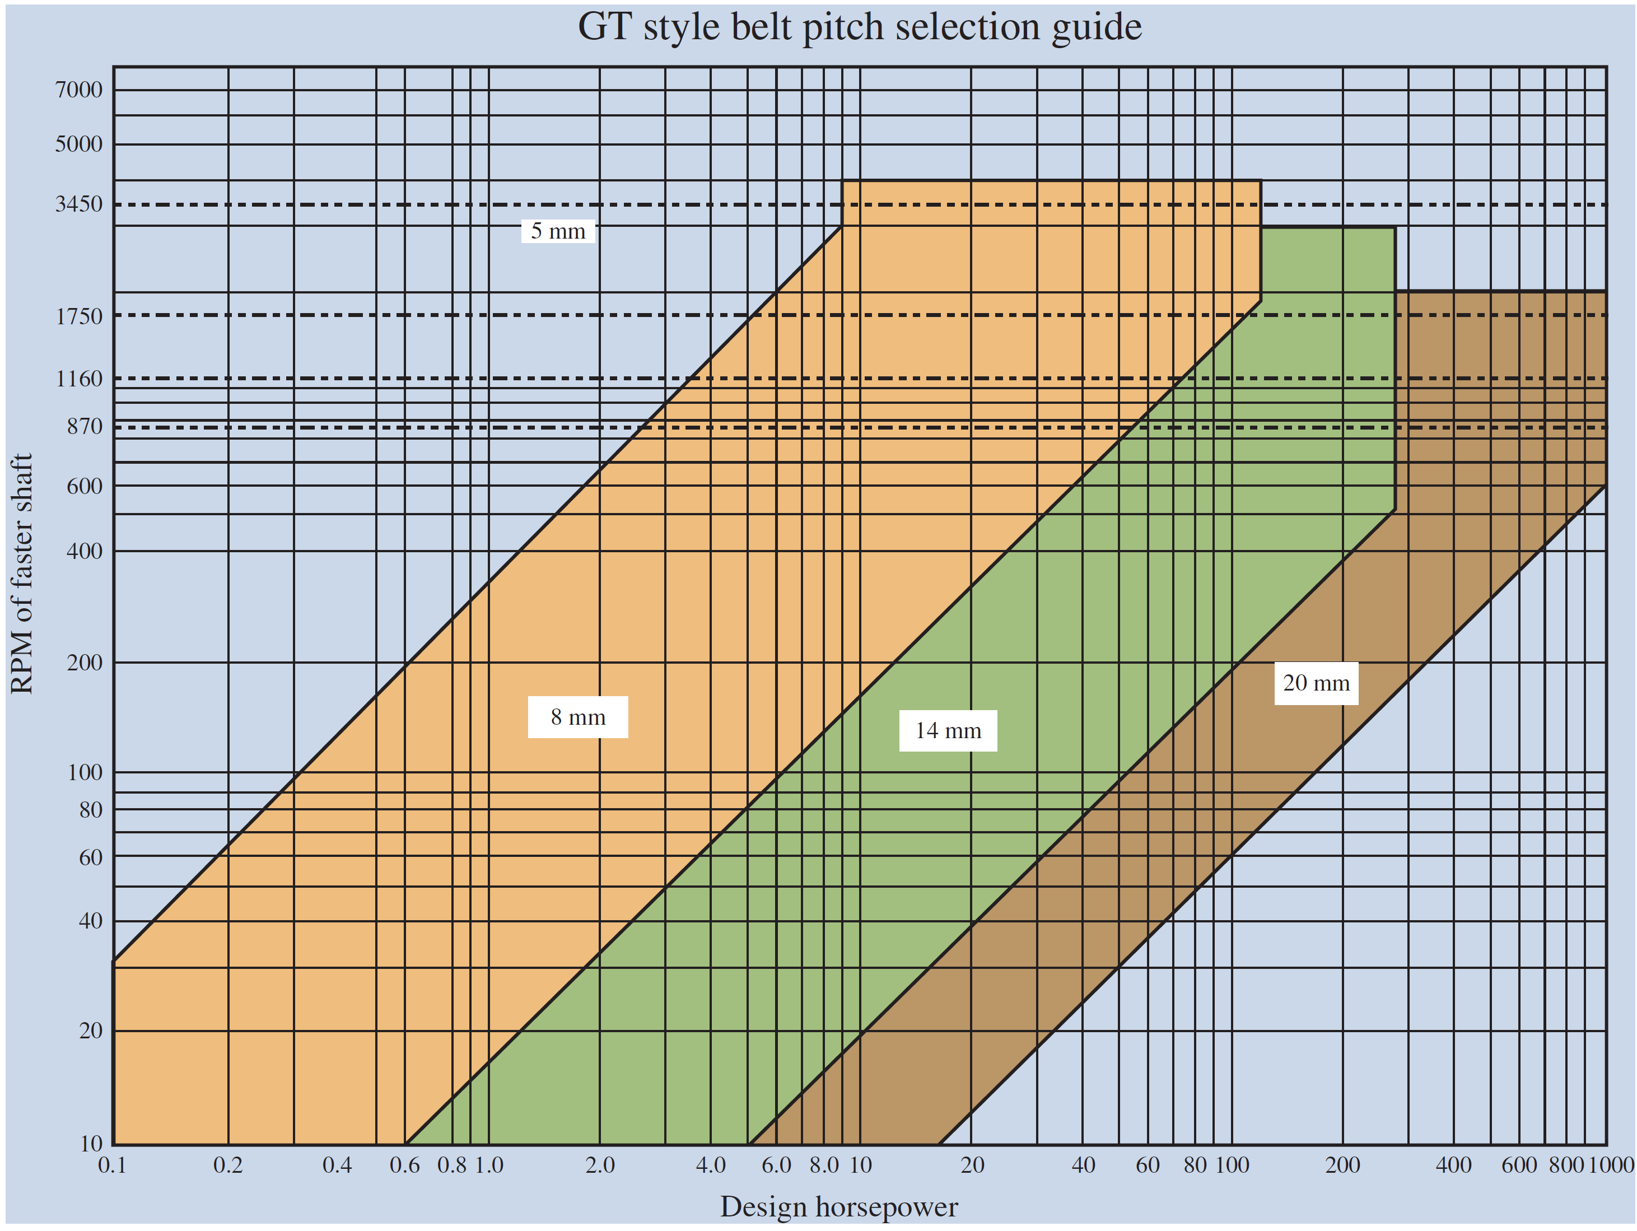
Sprocket Designations
Table 7–4 shows the available sprockets with a pitch of 8 mm.
The corresponding taper-lock bushing number is given for each sprocket and is based on the sprocket width.

Slide 28
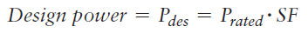
General Selection Procedure for Synchronous Belt Drives
Specify the speed of the driving sprocket (typically a motor or engine) and the desired speed of the driven sprocket.
Specify the rated power for the driving motor or engine. The rated power of the motor or engine is based on the calculated power of the driven machine.
Determine a service factor (SF) using Table 7–8.
Calculate the design power by multiplying the driver rated power by the service factor.

Slide 29
General Selection Procedure for Synchronous Belt Drives
Determine the required pitch of the belt using the belt pitch selection guide Figure (7-27). The belt pitch is based on the design power and the angular velocity of the faster (smaller) sprocket.
Calculate the velocity ratio VR between the driver and driven sprockets.
Select the candidate combinations using Table 7–7 of the number of teeth in the driver sprocket to that in the driven sprocket that will produce the calculated velocity ratio, VR.

Slide 30
General Selection Procedure for Synchronous Belt Drives
Eliminate the sprocket combinations that will not work due to space limitations and shaft diameter requirements. Some of the larger sprockets may interfere with the machine or guarding and can be eliminated due to these space limitations.
Using the desired range of acceptable center distances, determine a standard belt length that will produce a suitable value. Table 7–7 shows that the center distance is determined by the belt length and sprocket velocity ratio.

Slide 31
General Selection Procedure for Synchronous Belt Drives
Selection of the width of the belt: An 8-mm pitch belt is available in four different widths: 20 mm, 30 mm, 50 mm, and 85 mm. The belt width selection Tables 7–9 and 7–10 are shown for the 30-mm and 50-mm wide belts.
You will notice for a given sprocket size as the speed increases, the power rating of the belt increases.
A larger sprocket will decrease the belt width required and yield a longer service life. The belt width should not exceed the sprocket diameter.

Slide 32
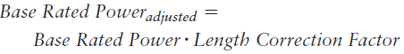
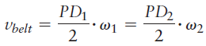
General Selection Procedure for Synchronous Belt Drives
Catalog data will show factors less than 1.0 for shorter belt lengths and greater than 1.0 for longer belt lengths.
Calculate the belt linear velocity. Belt speeds above 3500 fpm increase the noise level of the synchronous belt drive.

Slide 33
General Selection Procedure for Synchronous Belt Drives
Specify the final design details for the belt drive system. This includes all sprockets, type and bore size of taper-lock bushings, belt, and tensioner if required. Summarize the design, check compatibility with other components of the system, and prepare the purchasing documents.

Slide 34
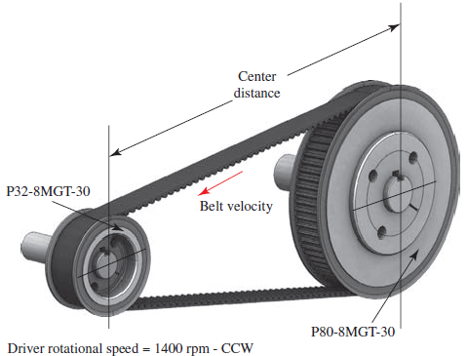
Example Problem
For the belt drive layout shown in Figure 7–28 perform the following calculations for the kinematics of the drive:

Slide 35
Example Problem
For the belt drive layout shown in Figure 7–28 perform the following calculations for the kinematics of the drive:
Specify the number of teeth and the pitch diameter of each sheave.
Calculate the velocity ratio of the belt drive and the angular velocity of the driven sheave.
Calculate the belt linear velocity.
Determine the center distance using a 1200- MGT-30 belt.

Slide 36
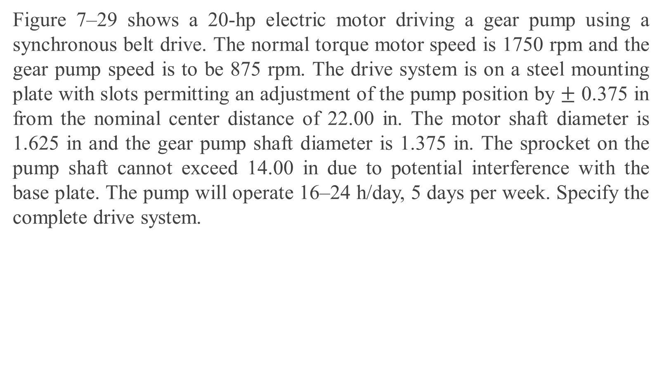
Example Problem
Figure 7–29 shows a 20-hp electric motor driving a gear pump using a synchronous belt drive. The normal torque motor speed is 1750 rpm and the gear pump speed is to be 875 rpm. The drive system is on a steel mounting plate with slots permitting an adjustment of the pump position by $±$ 0.375 in from the nominal center distance of 22.00 in. The motor shaft diameter is 1.625 in and the gear pump shaft diameter is 1.375 in. The sprocket on the pump shaft cannot exceed 14.00 in due to potential interference with the base plate. The pump will operate 16–24 h/day, 5 days per week. Specify the complete drive system.

Slide 37
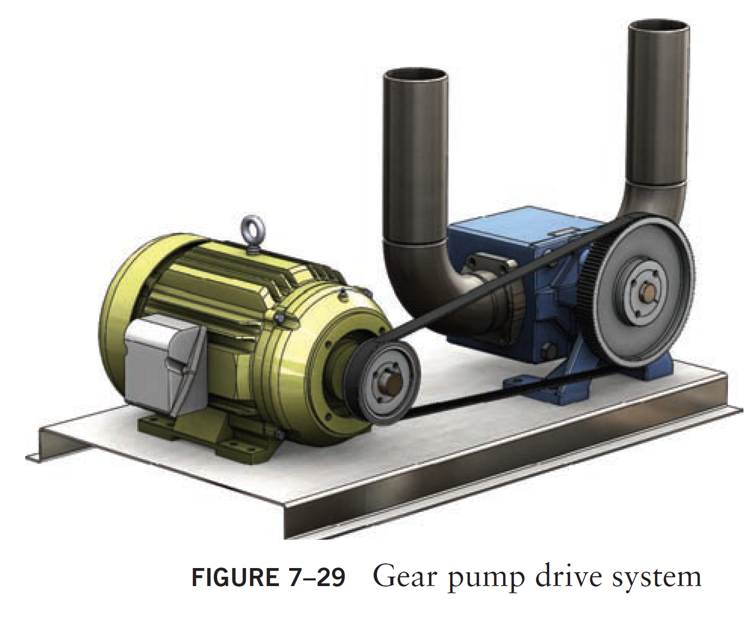
Sprocket Designations
Example Problem

Slide 38
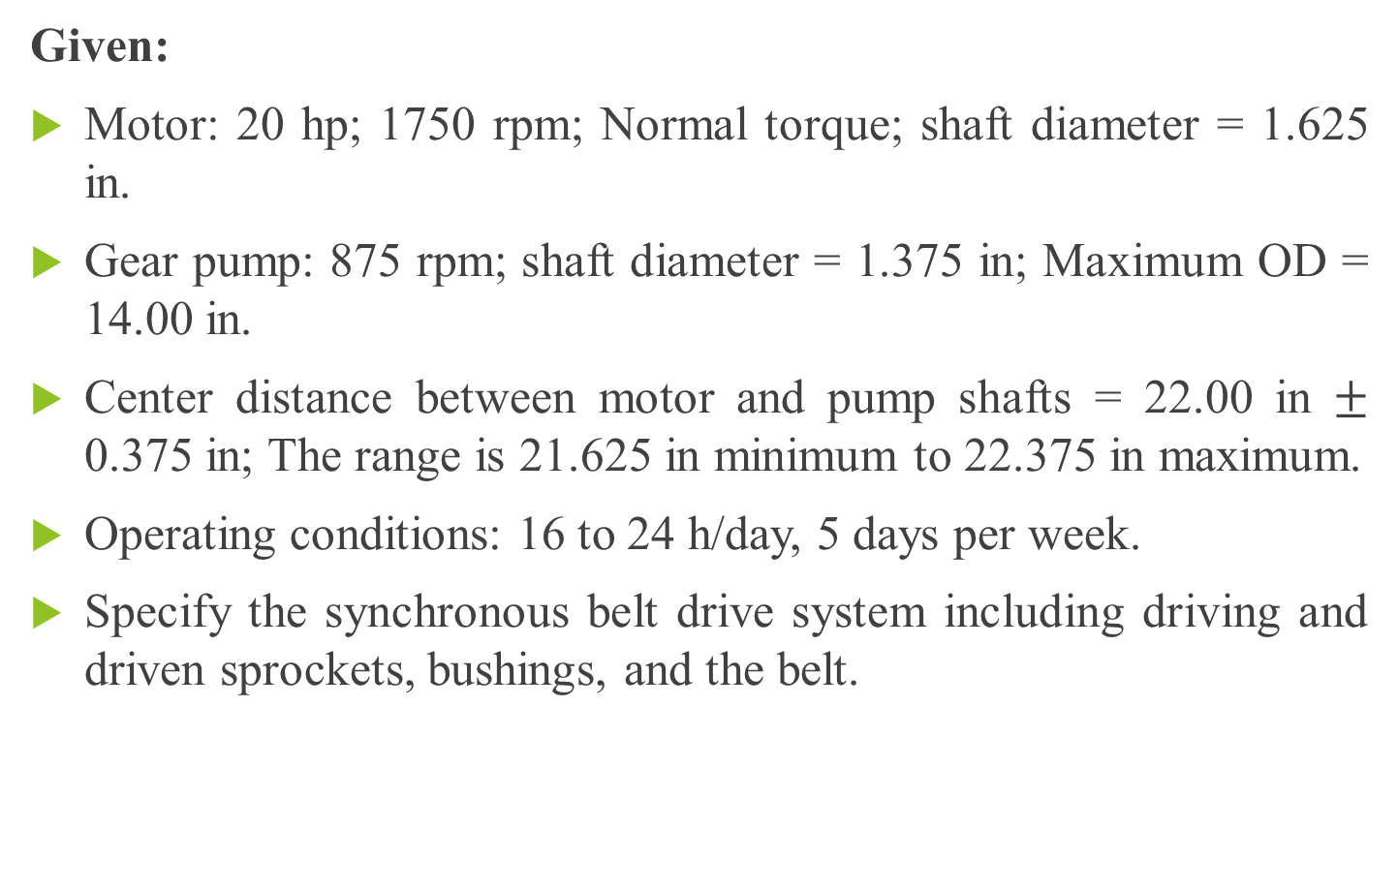
Example Problem
Given:
Motor: 20 hp; 1750 rpm; Normal torque; shaft diameter = 1.625 in.
Gear pump: 875 rpm; shaft diameter = 1.375 in; Maximum OD = 14.00 in.
Center distance between motor and pump shafts = 22.00 in $±$ 0.375 in; The range is 21.625 in minimum to 22.375 in maximum.
Operating conditions: 16 to 24 h/day, 5 days per week.
Specify the synchronous belt drive system including driving and driven sprockets, bushings, and the belt.

Slide 39
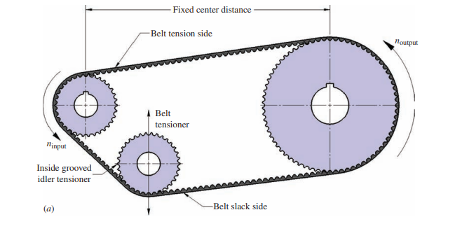
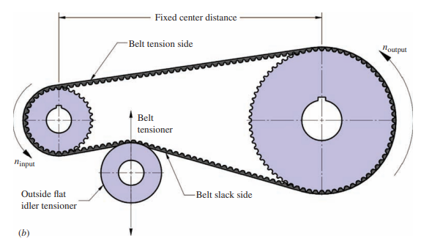
Alternate Configurations for Synchronous Belt Drives

Slide 40
Tensioner Pulleys
The belt tension can be maintained during operation, for example, by means of tensioner pulleys.
Tensioning pulleys also serve to cushion heavy load changes.
In addition, the wrap angle can be increased by tensioner pulleys.
Tensioner pulleys are also often used for long belt lengths to prevent excessive belt vibration.

Slide 41
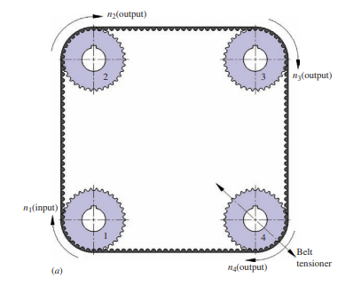
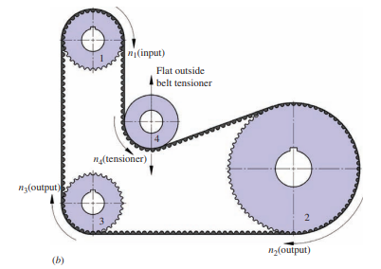
The tensioner may decrease the life of the belt and the belt manufacturer should be consulted.

Slide 42
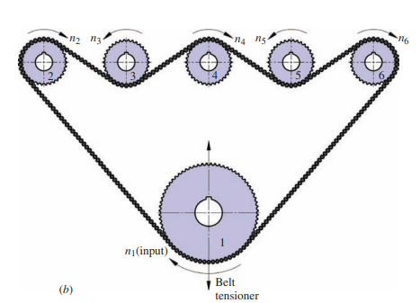
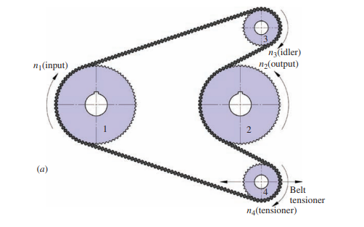
Twin Power Belts
Serpentine Belt drive configurations

Slide 43
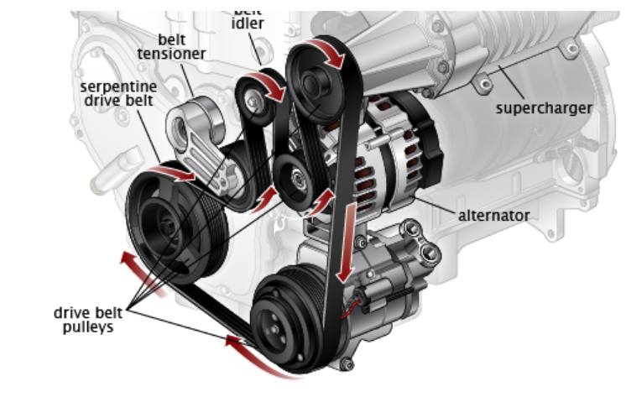
Do all cars have serpentine belts?
Most modern vehicles do have serpentine belts, but older models can have v-belts. The serpentine belt is a single, continuous belt that operates multiple devices in an engine including the alternator, air conditioner, water pump, and power steering pump. In engines that have v-belts.
Individual belts operate these components and the automobile can have up to four different belts.
The advantage of a serpentine belt is its efficiency.
Having a single belt increases fuel economy and available power.
The disadvantage of a serpentine belt is if it breaks several critical functions of the engine are lost and the engine will conk out leaving you stranded.

